Slide 1
I Was Told There Would Be No Math: Employment Statistics 101 for non-Statisticians
Rick Holt, Ph.D.
Andrew Turnbull, Esq.
Paul White, Ph.D.
August 2, 2017

Slide 2
Statistics are Central to Modern Title VII Litigation

Slide 3
Why Statistics Matter
“[F]igures speak and when they do, courts listen”
    Rowe v. General Motors Corp., 457 F.2d 348 (5th Cir. 1972)
“[O]ur cases make it unmistakably clear that ‘[s]tatiscal analyses have served and will continue to serve an important role’ in cases in which the existence of discrimination is a disputed issue.”
    Teamsters v. United States, 431 U.S. 324 (1977)

Slide 4
Recent Verdicts and Settlements
Court awarded $1.6M to black and Hispanic job applicants related to discriminatory pre-employment test
Large bank agreed to pay $35M to class of 365 African-Americans in racial glass ceiling promotion and pay case
Manufacturer of semiconductors and telecomm equipment agreed to pay $19.5M to end systemic pay and promotion claims class of 3,290 females
OFCCP Conciliation Agreements
  Risk intelligence provider agreed to pay over $1.2M to resolve allegations of systemic pay discrimination against women
  Technology company agreed to pay $2.7M to resolve allegations that it discriminated against 872 African-American and Asian applicants who applied for positions and extend 11 job offers
  Meat processor agreed to pay $1.6M in back pay to 5,716 applicants and extend 474 job offers for alleged hiring discrimination on the basis of sex, race, and/or ethnicity

Slide 5
Legal Framework Under Title VII
Disparate Impact
  Plaintiff must show facially neutral employment practices that have statistically significant adverse on a protected group
  Employer can rebut by attacking statistics, introducing alternative statistics, or showing the employment policy or practice is job related and consistent with a business necessity
  Plaintiff can still prevail if shows that the employer refused to adopt an alternative practice that could satisfy the employer’s legitimate interests without having a disparate impact on a protected class
Pattern or practice
  Plaintiff must show that employer had a pattern or practice of intentional discrimination (i.e., discrimination is standard operating procedure); plaintiff usually combines statistics with other evidence of discrimination (e.g., biased statements)
  Employer can rebut by attacking statistics, introducing own statistics, or showing a legitimate non-discriminatory reason for the pattern or practice
  Plaintiff can still prevail if shows that defendant’s evidence is false

Slide 6
Role of Statistics in Title VII Discrimination Cases
Statistics provide descriptive evidence
  Basis for inference
  Establish a pattern
Statistics must show sufficiently large disparity that is unlikely to have occurred by chance
Various tests used to show disparity is not by chance
  Standard deviations test
  Probability tests (one or two tailed)
  Multiple regression analysis
  Cohort analysis
  80% rule (rule of thumb)

Slide 7
Validity of Statistics
Statistics alone can establish a prima facie case but are not accepted uncritically
Statistical tests must contain the right assumptions
  Type of case pled
  Tailored to specific employment practice at issue (e.g., hiring, promotion, compensation, testing, etc.)
  Analyze the right group(s) (e.g., similarly situated comparators)
  Model how the employment process actually works
  Consider all important factors for which data is available or can reasonably be collected
  Contain accurate and complete data

Slide 8
Battle of Statistics
Plaintiff comes forward with statistics to show prima facie case
Employer defense
  Offering own statistics to show no adverse impact
  Exposing methodological flaws that render plaintiff's results questionable or invalid
    Compares inappropriate groups or inappropriate locations
    Wrong data source (e.g., actual or potential applicant flow)
    Do not control for legitimate factors, such as education or training
    Bottom line statistics
    Sample size is too small
    Timeframe invalid
  Practical significance

Slide 9
What are the Odds of that Happening?

Slide 10

Probability and Chance
We use statistics to address three questions
  Do the observed outcomes match the predicted outcomes based on a neutral decision process?
  If the observed outcomes do differ from the predicted outcomes, how far apart are they?
  Is the difference sufficiently small that it can be ascribed to random chance?

Slide 11
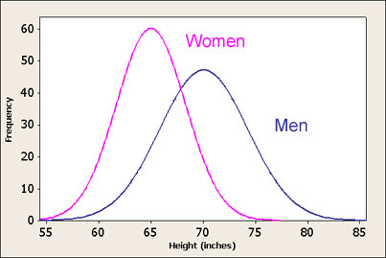
Randomness and Expectations
Individual events may be random – but we can make predictions about the process
  Draw 10 balls from an urn that contains 80 green balls and 20 red balls – how many balls do we expect?
  Measure the height of 100 men – how many will be shorter than 5’4”?
  Pitch to Bryce Harper 20 times – how many hits will he get?
Probability – the measure of likelihood – is a key tool

Slide 12
Normal Distribution
Important in statistics
Mimics reality of many natural processes
  Height or Weight
  Temperature
  Scores on a Test
  Blood Pressure
Mathematically tractable
Central Limit Theorem
  Some data sets follow a normal distribution. Others do not. However for both normal and non-normal data, if we repeatedly take independent random samples of size n from a population, then when n is large, the distribution of the sample means will approach a normal distribution.

Slide 13
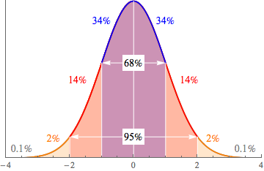
Standard Normal Distribution

Slide 14
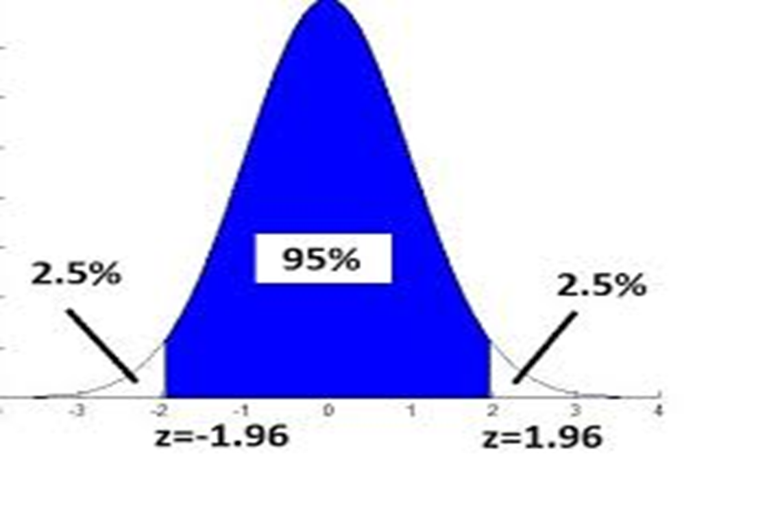
Statistical Significance Threshold

Slide 15
Selections

Slide 16

Classic Coin Toss Experiment
Flip a coin 20 times
  How many heads do we expect?
  How likely is that we will get more than
    12 heads?
    15 heads?
Statistics allows us to compute the expected probability of each outcome

Slide 17
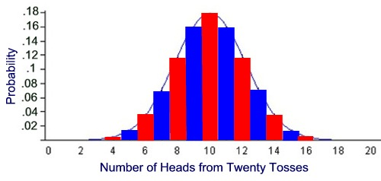
Distribution of the Number of Heads

Slide 18
Computing the Probabilities is Easy
How many heads is too many? At what point do we call into question whether the coin is fair?

Slide 19
Application to Hiring
Pool of Job Applicants -> People in this audience
Hires Applicants -> People holding a ball when time is called
What do we need to know in order to evaluate whether or not the process is neutral with respect to gender
  Share of the audience that is female
  Number of hires
  Number of female hires
What do we want to know
  Actual number of female hires
  Expected number of female hires
  Difference
  Level of Significance

Slide 20
Audience Hiring Analysis Exercise

Slide 21
Complications to the Lottery Model
Is it the case that each applicant has the same probability of being selected?
  Do they all meet minimum qualifications?
  Are they all identical with respect to job qualifications?
  Are the hires occurring at the same time at the same location (same posting)?
It is important to only compare similarly situated employees when evaluating whether or not there are disparities in the selection process
  Conduct multiple pools analyses for each SSEG and then use appropriate statistical techniques to combine the results of those tests
  Conduct regression analysis that allows you to simultaneously control for differences in applicant characteristics

Slide 22
Comparison of Averages

Slide 23
Is there a Gender Difference in Average Pay
Under what circumstances can we assume that men’s and women’s pay is drawn from the same overall distribution
We can test whether the underlying population mean is identical by comparing the sample means

Slide 24
Compare average using the t-statistic
Requires knowing the counts, average, and standard deviation of pay for men and women
The t-stat is the difference divided by the standard deviation. Any value over 1.96 is statistically significant.

Slide 25
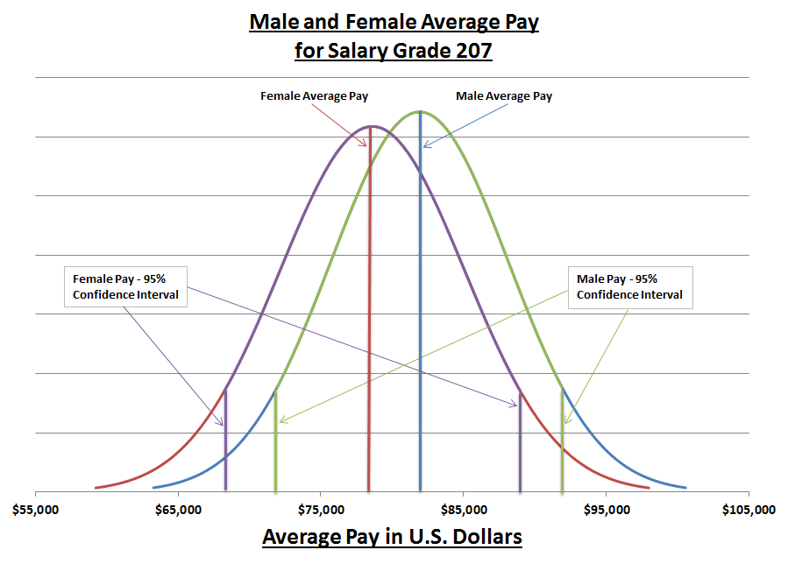

Slide 26
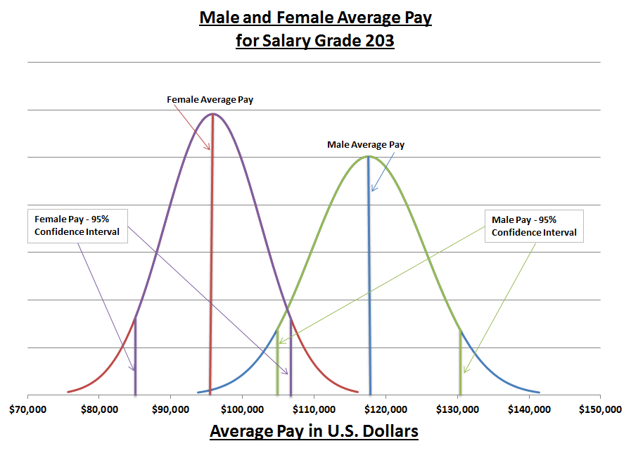

Slide 27
Are t-tests the Best Tool?
Pro –
  Straight-forward to implement
  Minimal data requirements
Con –
  Sensitive to outliers – especially in smaller samples
  Doesn’t allow us to control for relevant differences among subjects within the sample
We often turn to regression analysis because when analyzing compensation within a group of employees – it is rarely appropriate to assume they are identical with respect to all the factors that influence pay

Slide 28
Multiple Regression

Slide 29
Why do we need Regression?
Findings of average differences are not informative about real pay disparities because:
  Comparisons need to be made between similarly-situated employees
  Are the differences close enough that they are not statistically significant?
What does regression do?
  Simultaneously estimates the relationship between salary and a number of other factors based on observed factors in the data
  Allows for variation in the form of a normally distributed random variable (the error term)
  Allows us to test if there is a statistically significant relationship between a demographic variable and salary

Slide 30
Simple Regression Analysis of Salaries
Actual Salary = a + b (Time in Company) + ε
Random
Component
(Error Term)
Dependent
Variable
Coefficient
(Impact)
Constant
(Intercept)
Explanatory
(independent)
Variable
Salary = $119,505 + $601 (Time in Company)
(t=2.03)
(t=44.7)

Slide 31
Salary with an Overall Trend

Slide 32
Salary with Gender

Slide 33
Salary with Gender Trend

Slide 34
Multiple Regression Analysis of Salaries
Salary = a + b (Time in Company) + c (Female) + ε
Salary = $118,439 + $604 (Time in Company) – $502(Female)
(t=2.05)
(t=46.1)
(t=-1.8)
Multiple regression estimates the coefficients by “fitting a line” that minimizes the sum of the squared residuals (or deviations)

Slide 35
Salary with Standard Deviation

Slide 36
Regression can be used to Identify Outliers
Generate a predicted salary
When the difference between actual salary and predicted salary is ‘large’ then the person is an outlier

Slide 37
Outlier Analysis – Excel Exercise

Slide 38
Data is More than Half the Battle

Slide 39
Data Quality is a Constant Challenge
HRIS data complications
  Default values
  Inconsistent coding
  Inconsistent definition
  Illogical dates
  Missing information
Data retention can be a challenge as well
  Legacy systems
  Mergers and Acquisitions
Let’s review a sample

Slide 40
Conclusions

Slide 41
Key Statistical Concepts
Comparing Actual vs Expected
Importance of Similarly Situated
  How to partition the sample
  What differences are important to control for within the sample
Deviation from Expected – When is it Statistically Significant?
Data Quality is a Threshold Criteria

Slide 42
Key Legal Concepts
Which party has the burden of proof and what must be proved
How do statistics play into the theme of the case
Do the statistics tests contain the right assumptions
Does the statistics cover the right timeframe (statute of limitations)
Who is similarly-situated
Do the statistics make sense in light of surrounding facts and circumstances

Slide 43
Terminology Appendix

Slide 44
Terminology
Hypothesis Test
  Statistical test used to determine if there is enough evidence in a sample of data to infer that a certain condition is true for the entire population
  Examines two opposing hypotheses about a population:
    null hypothesis
    alternative hypothesis
Significance Level
  Probability of the analysis rejecting the null hypothesis, given that it is true
  Denoted as alpha or α
  Also referred to as Type I Error
  By academic custom and legal precedent – almost always set at 5%

Slide 45
Terminology
Probability Value
  Probability of the observed sample or some other more unlikely sample, given that the null hypothesis is true
  Denoted as p-value or p
  When the probability value is less than the significance level, then the result is statistically significant
Standard Deviation
  Measure used to quantify the amount of variation or dispersion of a set of data values.
  Represented by sigma σ
  A low standard deviation indicates that the data points tend to be close to the mean (expected value) of the set, while a high standard deviation indicates that the data points are spread out over a wider range of values.
  Square root of variance

Slide 46
Terminology
Confidence Level
  Interval estimate (of a population parameter) that is computed from the observed data
  Range of values (interval) that act as good estimates of the unknown population parameter
R-square
  Statistical measure of how close the data are to the fitted regression
  Percentage of the response variable variation that is explained by a linear model
  Always between 0 and 1

