Slide 1
What’s the Message? A Compelling Case for Your Disability Inclusion Efforts
Katherine McCary
Shaun McGill
U.S. Department of Labor (DOL)
Office of Disability Employment Policy (ODEP)

Slide 2
Agenda
Introduction to ODEP and Disability
Research Findings About Messaging from Leading Business Schools
Strategies, Success Stories and Resources
LEAP

Slide 3
Office of Disability Employment Policy (ODEP)
The only non-regulatory federal agency that promotes policies and coordinates with employers and all levels of government to increase workplace success for people with disabilities
dol.gov/odep

Slide 4
Emerging Topics
Return-to-Work
Early Intervention Demonstrations
Neurodiversity
Mental Health Disabilities
dol.gov/odep

Slide 5
Disability as Diversity
Represents talent with a variety of skills and abilities, just like any other any diverse segment
Crosses all other diversity dimensions
Anyone can join at any time

Slide 6
Key Community/Market Statistics
Globally:
According to WHO, one billion people live with a disability: 15% of the world’s population
Market is the size of China
Influences more than $8 trillion in annual disposable income
Within the U.S.:
Third largest market segment—56.7 million according to Census Bureau
Purchasing power of $5 trillion (including family, friends and allies)

Slide 7
Disability 101
People with disabilities are people first
82% of disabilities are acquired
71% of disabilities are non-apparent
Disability Etiquette Golden Rule: “Always Ask, Never Assume”

Slide 8
Wharton School of Business
Marketing approach based on persuasive arguments
Positive messaging
Avoid reinforcing negative norms
Tailor messages based on employer readiness
Choir
Inclusives
Uninitiated
Who is ready to join the choir?

Slide 9
Georgetown McDonough School of Business
Inclusive businesses in high-growth industries
Messages tested
Business case
Human interest case
Regulatory case
Reaction to messaging
Conclusion

Slide 10
Audience Discussion: Disability Inclusion
What are your positives?
Where is your pain?

Slide 11
Addressing Roadblocks and Bottlenecks
Senior leader buy-in
Concern for cost of accommodations
Attitudinal
Hiring managers’ concerns re: productivity, absenteeism, language/etiquette
Who and where are employees and talent with disabilities?
Disclosure/self-identification
Talent pipeline
Others?

Slide 12
Best Practices for Creating a Disability-Inclusive Culture
Articulate why employing people with disabilities is important to your business
Put a face on disability by sharing stories of employees with disabilities
Foster a strong disability employee resource group/business network
Capitalize on the convergence of aging and disability in the workforce
Help managers and employees become “disability confident”

Slide 13
Strategies and Success Stories
It’s all about culture change
Messaging makes the difference

Slide 14
Building a Disability-Inclusive Culture that Engages All Employees: Employer Strategies for Taking the “LEAP”
Leadership
Education
Accessibility & Accommodations
Pipeline

Slide 15
Leadership
Branding: Senior leaders discuss and publicly promote disability initiatives
Organization has:
A disability champion to drive the disability strategy
A written diversity policy that specifically includes disability
An active ERG for disability (executive sponsor, budget, etc.)
A publicized centralized accommodation process and budget

Slide 16
Leadership
External and internal websites include disability statements, ERGs
Internal and external communications are inclusive and accessible
Budget for education, accessibility, accommodations, internships and community outreach
USBLN® and BLN Affiliate Leadership

Slide 17
Leadership
ODEP resource that helps employers hire and retain workers with disabilities
AskEARN.org

Slide 18
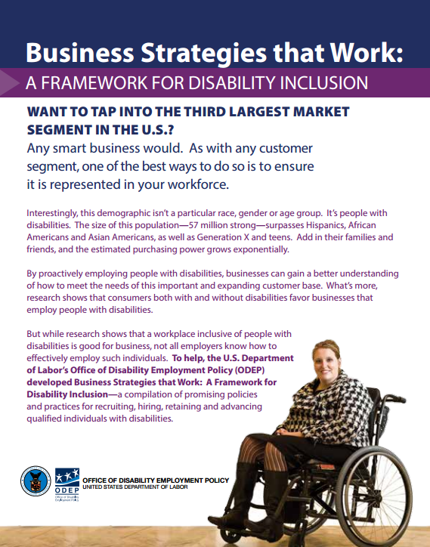
Business Strategies that Work
Lead the Way
Hire (and Keep) the Best
Ensure Productivity
Build the Pipeline
Communicate
Be Tech Savvy
Grow Success

Slide 19
Education
Self ID campaign
Written accommodation policy and procedures with manager training
Accommodation process shared with new hires during onboarding and performance reviews
Onboarding includes statement of disability inclusion and shares ERG opportunities

Slide 20
Self ID/Disclosure – What’s the Difference?
Self Identification (Self ID)
Invitation required for Federal contractors
Collected for retention data and analysis
Data not accessible to workforce
Self Disclosure
Not required by regulations
Required only when requesting an accommodation
An especially personal decision for those with non-apparent disabilities

Slide 21
Culture is the Driver
A successful self ID campaign will encourage self disclosure
Inclusive Culture
Self Disclosure
Self ID

Slide 22
Self ID Campaign: Common Steps
Senior Leadership
Assemble the Team
Current State
Create the Campaign
Distribution Channels
Execute
Monitor

Slide 23
Education
Training for all: Accessible and ongoing webinar, e-learning and small group training for Hiring Managers, Talent Acquisition Professionals, Business Partners, ERGs and all employees
Address cultural and social barriers that may negatively impact employees with disabilities
Easy access to short training (e-micro learning)
BLN Affiliate Programs
Hiring Manager Opportunity
NOD Disability Tracker, USBLN DEI

Slide 24
Resource: Campaign for Disability Employment
Nationwide campaign funded by ODEP
Public/private collaboration with leading business and disability organizations
Policy driven with focus on personal and positive stories and imagery

Slide 25
Resource (continued 1)
Campaign for Disability Employment
Features:
Public service announcements
Discussion guides
Posters, ads and other web and print materials
Social media
Practical ideas

Slide 26
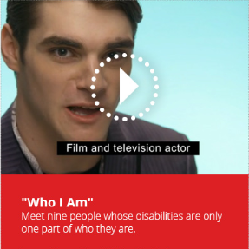
Resource (continued 2)

Slide 27
Resource (continued 2)
National Disability Employment Awareness Month (NDEAM)
Month-long focus in October to celebrate the contributions of America’s workers with disabilities
Theme, poster and web-based resources for employers
2016 Theme: #InclusionWorks

Slide 28
Resource: 2016 NDEAM Poster

Slide 29
Accessibility
Company’s website is 508 compliant
All company facilities, technology and operations are accessible and focused on Universal Design
Interview process does not eliminate certain groups of individuals with disabilities (i.e., individuals with autism)

Slide 30
Resource
Promotes the employment, retention and career advancement of people with disabilities through the development, adoption and promotion of accessible technology
Accessible Technology Action Steps Employer Guide
TalentWorks
TechCheck
Webinars/PEAT Talks
PEATWorks.org

Slide 31
Accessibility (continued
Universal Design
Increases potential for a better quality of life for a wide range of individuals
Reduces stigma by putting people with disabilities on an equal playing field
Promotes self-reliance and social engagement
Not a substitute for assistive technology, but helps people with functional limitations and society as a whole

Slide 32
Accessibility (continued
Universal Design Common Workplace Features – Examples
Adjust light levels at workspaces to best fit requirements for specific tasks, individual abilities and preferences
Situate workstations so employees can communicate effectively with visual and/or verbal modes of communication
Offer both standing and seated workstation positions, also referred to as "sit-stand" workstation

Slide 33
Accommodations Resource
The leading source of free, expert and confidential guidance on workplace accommodations and disability employment issues
AskJAN.org & jan@askjan.org
(304) 216-8189 via Text
janconsultants via Skype
(800) 526-7234 (Voice)
(877) 781-9403 (TTY)
AskJAN.org

Slide 34
Accommodations
Cost of Accommodations
JAN Interviewed 1,157 employers between 2008 and 2016
A range of industry sectors and sizes
59% of accommodations cost absolutely nothing
The rest typically cost only $500
AskJAN.org

Slide 35
Resources
Employers' Practical Guide to Reasonable Accommodations: AskJAN.org/Erguide
JAN Workplace Accommodation Toolkit: prod.askjan.org/toolkit/#
Resources and publications: askjan.org/media/index.htm
AskJAN.org

Slide 36
Pipeline: Community
Strong community outreach to tap talent sources
Host “meet and greet” after-hours events for both individuals with disabilities and community rehabilitation groups
Invite community partners into your organization to meet with hiring managers and learn job requirements
Partner with and support ($$) national non-profits with local chapters (MS Society, the Arc, Goodwill, etc.)
Engage ERG and allies to participate in local community events

Slide 37
Pipeline: College
Build collaborative relationships with College Career and Disability Services Offices
Create expectations for Career Services and set goals for recruiting candidates with disabilities for jobs and internships
Educate your University Relations/Campus Recruiters about disability on campus (non apparent) and include people with disabilities in your recruitment
Engage campus disability organizations and professional associations
Establish and promote specific internships: Emerging Leaders, AAAS, USBLN® Career Link
Recruit at disability-focused universities: Gallaudet, RIT
Host Virtual Career Fairs

Slide 38
Pipeline: Branding
Attend and speak at conferences to show commitment and interest in recruiting and hiring candidates with disabilities.
Engage with BLN to showcase your organization’s commitment
Understand that people with disabilities, just as any diverse population, apply without any affiliation to a (disability) group and are self selecting your organization based on your brand and community leadership

Slide 39
Pipeline: Strategy
Create written vendor agreements with community partners
Source from professional associations (engineers/doctors/chemists, etc. with disabilities)
Require disability hiring from your staffing vendors in your contracts
Diversify suppliers to include DOBE® certified or disability-owned firms

Slide 40
Pipeline Resource: Workforce Recruitment Program (WRP)
Connects federal and private-sector employers nationwide with highly motivated college students and recent graduates with disabilities
Summer or permanent jobs
In 2016, more than 300 accredited institutions, representing more than 1800 students participated
131 Veterans
151 Engineers
29 MBAs
104 Accountants
148 Health Care Professionals
39 Law Students
293 Computer-Based Majors
274 Graduate Students
21 Doctoral Candidates

Slide 41
Audience Discussion: What Will Your Message Be?

Slide 42
Q&A
Katherine McCary
McCary.Katherine.O@dol.gov
Shaun McGill
McGill.Shaun@dol.gov

