Slide 1
Creating Inclusion with
Assistive Technologies
Presented by Ryan Jones,
John Macko, and Lou Orslene
August 2, 2017

Slide 2
Introductions
Lou Orslene
Co-Director
Job Accommodation Network
John Macko
Director
NTID Center on Employment
Ryan Jones
Program Manager
VFO Group

Slide 3
Lou Orslene
Co-Director
Job Accommodation Network

Slide 4
Why is this important?

Slide 5
Accommodation = Equal Employment = Inclusion
The basis for inclusive employment is the reasonable accommodation (RA) policy and process
The foundation for reasonable accommodation is a robust interactive process (IP)
The trigger for RA and IP is a request for an accommodation or recognition of an obvious barrier to someone with a known disability
A request for accommodation includes two essential elements – a medical condition and a related challenge at work
Resource: OFCCP Pocket Card
http://www.dol.gov/ofccp/posters/files/ReasonableAccomodationPockectCard_10-15-15_JRFQA508c.pdf

Slide 6
Eight Most Common Types of RA
Modifying schedule or allowing leave time
Making workplace or work station accessible
Modifying methods – testing, communication, or training
Modifying or creating policies
Purchasing a service – reader or interpreter
Restructuring job
Reassignment
Purchasing or modifying equipment or
products

Slide 7
Cognitive Limitations
Limitations we hear of most often:
Memory
Attendance
Problem-solving
Issues of change
Working effectively
Handling stress and emotions
Maintaining stamina and concentration
Staying organized and meeting deadlines

Slide 8
Top 3 AT’s for Cognitive Limitations
Speech to text (Dragon)
Audio note takers (Sonocent, AudioNote)
Screen reading / highlighting software (JAWS)

Slide 9
AT for Cognitive Limitations
Apps:
Sosh - Cost $39.99
http://www.specialneeds.com/products-and-services/autism/special-needs-app-day-sosh
Equanimity - Meditation Timer & Tracker Cost - $4.99
https://itunes.apple.com/us/app/equanimity-meditation-timer/id351825794?mt=8
Worry Watch Cost - $1.99
http://worrywatch.com/
Relax Melodies - Cost Free
http://www.ipnossoft.com/
Breathe2Relax - Cost Free
http://t2health.dcoe.mil/
Relax & Rest Guided Meditations - Cost $1.99
http://www.meditationoasis.com/smartphone-apps/iphone-application-support/
Self-Help for Anxiety Management (SAM) - Cost-Free
http://sam-app.org.uk/

Slide 10
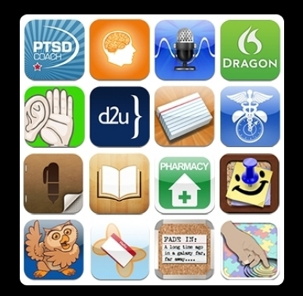
AT for Cognitive Limitations
Mobile Apps for People with Brain Injury
http://www.brainline.org/content/2013/12/life-changing-iphone-and-ipad-apps-for-people-with-brain.html

Slide 11
John Macko
Director
NTID Center on Employment

Slide 12
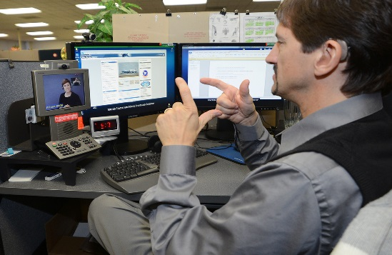
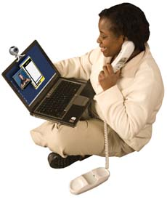
What are the top 3 Telephone Interview accommodations for deaf individuals?
Interpreter (In-Person)
Video Relay Services (VRS)
Captioned Telephone

Slide 13
What are the top 3 communication strategies for deaf employees?
Email/Text
Writing
Video Relay Services(VRS)

Slide 14
Job Accommodations
 | 1 to 1 | Small Group | Large Group
Video Relay Services(VRS) Using Sign Language Using Voice Using Text
Video Remote Interpreting (VRI)
Instant Conversations
Apps
Captioned Telephone
Interpreters

Slide 15
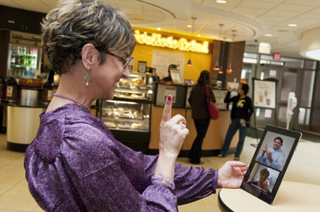
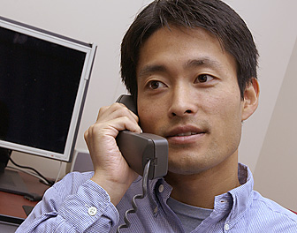
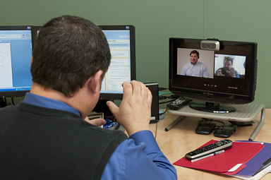
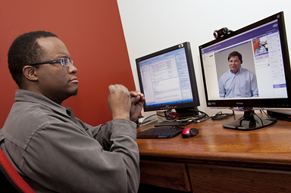
Using Sign Language and Voice
Hearing Caller
Deaf Callers

Slide 16
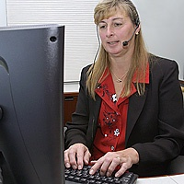
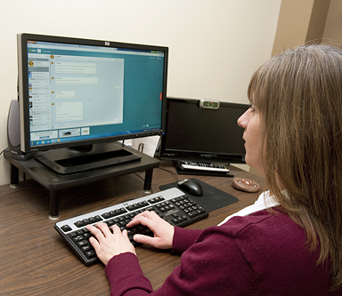
Using Text
Communication
Assistant
Deaf Caller
Hearing Caller

Slide 17
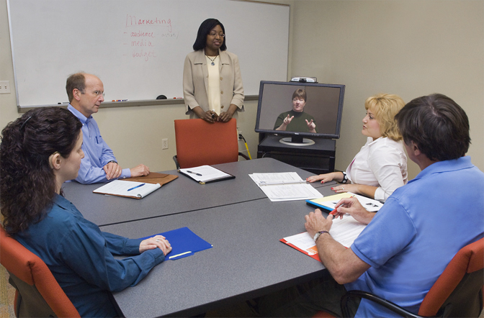
Video Remote Interpreting (VRI)

Slide 18
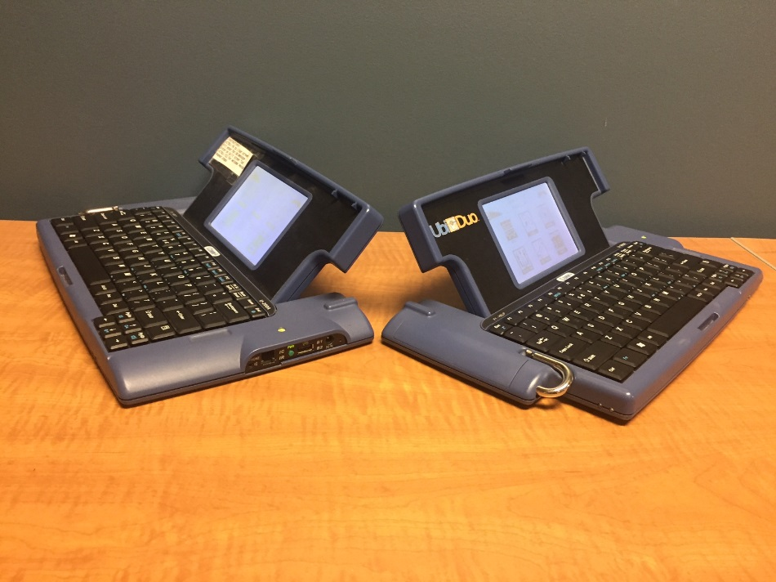
Instant Conversations

Slide 19
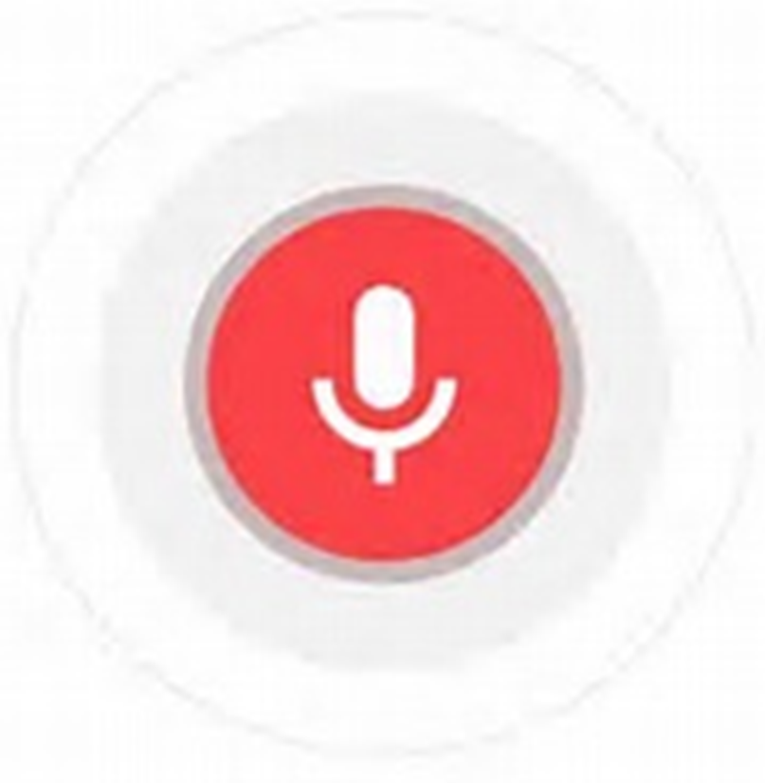
Apps
Automatic Speech Recognition (ASR) | Group Chat | Video Communication
Built-in ASR Notes Google Voice MS Translator | WhatsApp(desktop) (android) (iOS) | Facetime (iOS)
 |  | Skype (desktop) (android) (iOS)
Dragon (iOS) | Slack (desktop) (android) (iOS) | Tango (android) (iOS)
Ava (android) (iOS) |  | ZVRS, Sorenson, Purple, Convo (desktop) (android) (iOS)

Slide 20
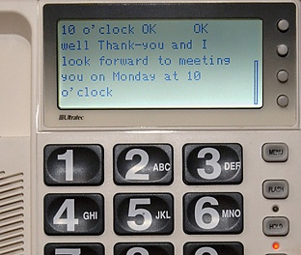
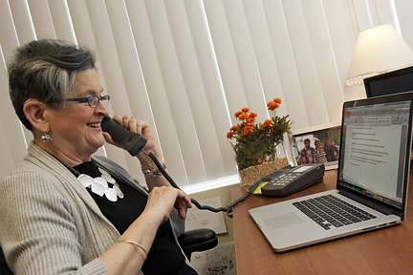
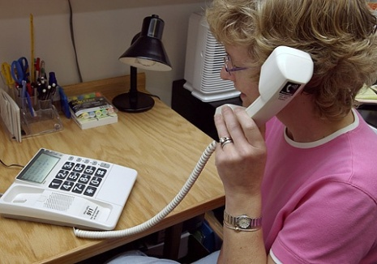
Captioned Telephone
Web Captioned Telephone
Captioned Telephone

Slide 21
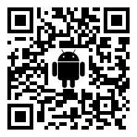
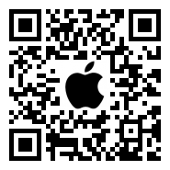
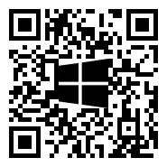
Communication
Additional lists related to deaf-hearing communication options:
Android apps
Apple apps
Windows apps

Slide 22
Ryan Jones
Program Manager
VFO Group

Slide 23
Screen Reading and Magnification
Most common assistive technology for computer users who are blind or have low vision
Provides powerful text-to-speech for speaking information on the computer screen (JAWS)
Provides a variety of visual enhancements for viewing information on the computer screen (ZoomText)
Can be combined together for the most powerful text-to-speech and magnification (ZoomText Fusion)

Slide 24
Capabilities of a Visually Impaired Computer User
Email and calendar
Word processing
Spreadsheets
Internet browsing
Presentations
Most all tasks that other employees do!

Slide 25
ZoomText Fusion
Live demonstration

Slide 26
Wrap UP
Please share:
What is your “take away” from today?
What assistive technologies will you start using after today?
Keep the conversation going:
Lou Orslene@jan.wvu.edu
John John.Macko@rit.edu
Ryan RJones@VFOGroup.com

